Slide 1

Explanations for Why-not Questions in Recommender Systems
Martti Grönholm
Vesa Haaparanta

Slide 2
How the method works
The method produces explanations for group recommendations for the granularity case for atomic case, group case, and position absenteeism case.
By leveraging a kNN approach and multiple sequences, it delivers diverse movie selections while maintaining transparency in the selection process.
This methodology emphasizes understanding individual movie recommendations, group genre preferences, and the significance of movie rankings. Such insights enhance user comprehension and trust in the recommendation system.
The emphasis on transparency in explaining the inclusion or exclusion of movies contributes to a more user-friendly and understandable recommendation process. Ultimately, this method enriches group experiences by tailoring recommendations to diverse tastes within the group.

Slide 3
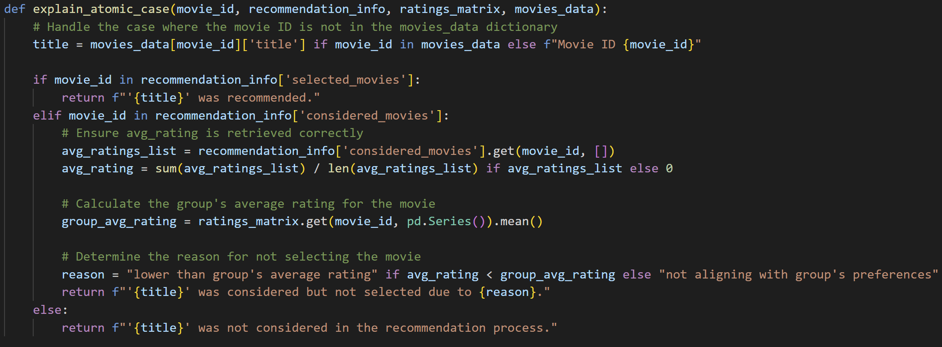
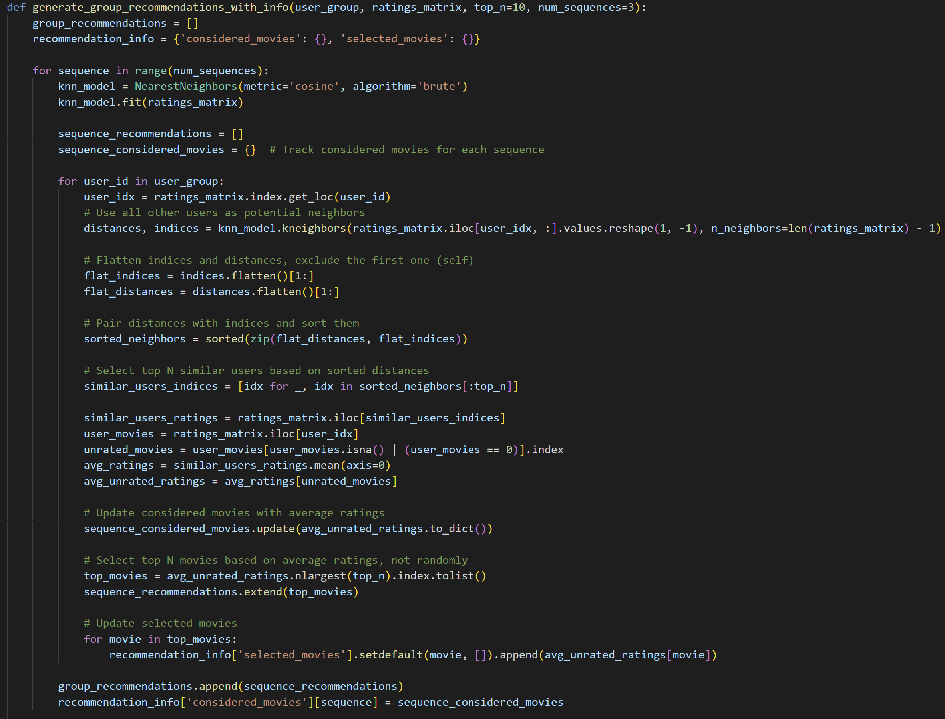
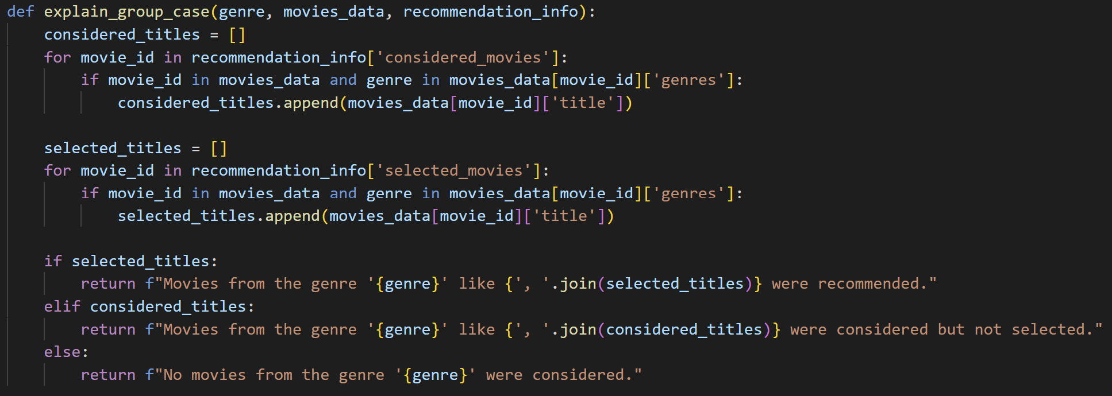
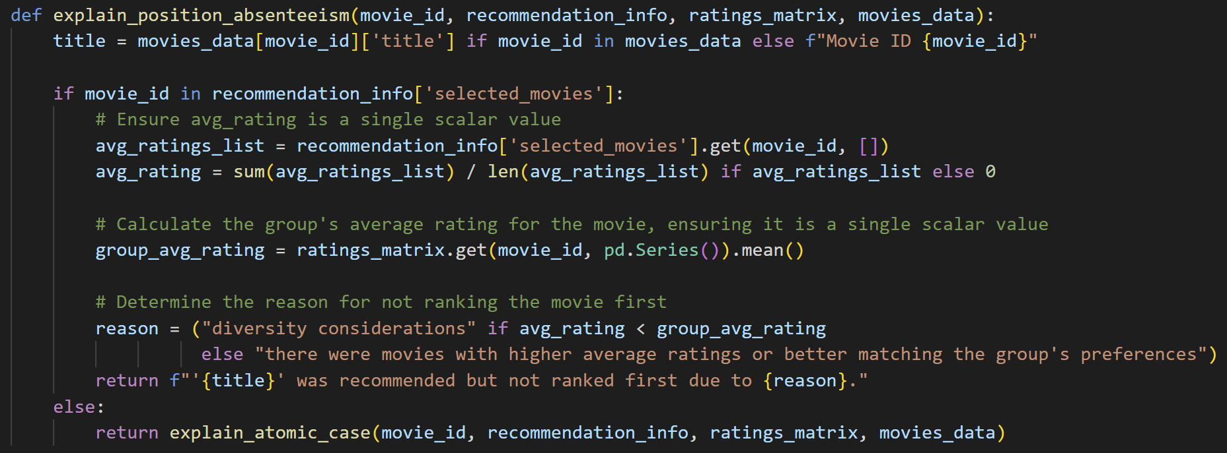
Function overviews

Slide 4
Function explanations
generate_group_recommendations_with_info
Generates group movie recommendations in multiple sequences
The use of multiple sequences with a kNN model for each allows capturing varied aspects of user preferences. By considering unrated movies from similar users, the recommendations are likely to align with the users' interests while maintaining diversity. Tracking both considered and selected movies enables detailed explanations for the recommendation logic.
explain_atomic_case
Provides an explanation for why a specific movie (atomic case) was or was not recommended to the user group.
Crucial for understanding the reasons behind the inclusion or exclusion of individual movies in the recommendation list.
explain_group_case
Explains why movies of a particular genre were or were not recommended to the user group
explain_position_absenteeism
Explains why a specific movie was not ranked first in the recommendation lis

Slide 5
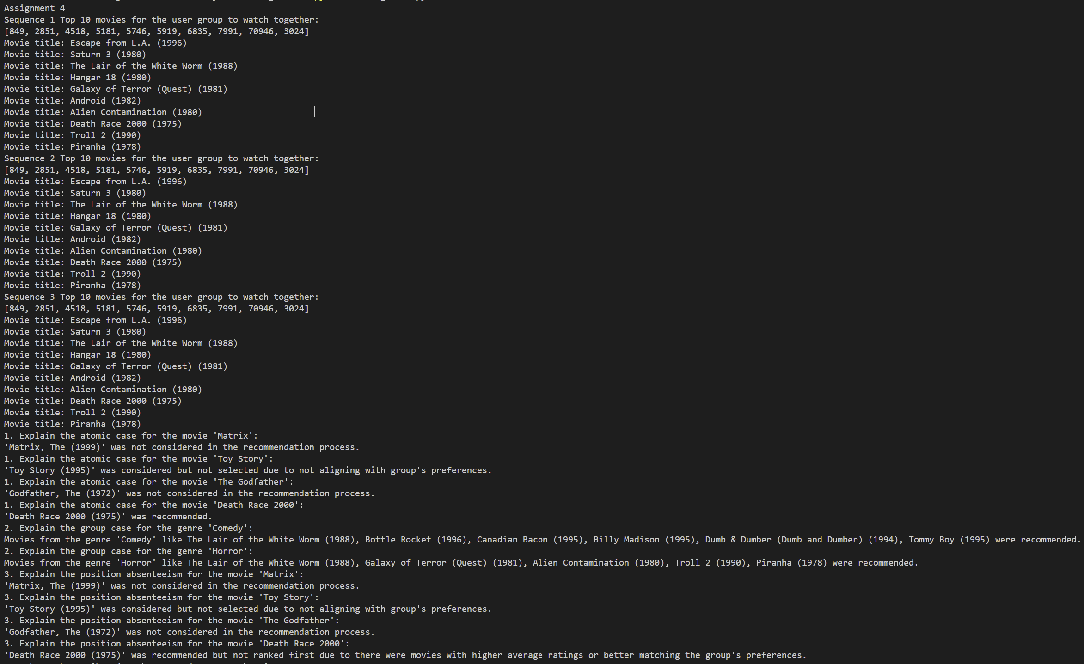
Conclusion
We can see that the method outputs top10 recommend movies in three sequences for the user group to watch together.
Then there are atomic case, group case, and position absenteeism explained for example movies.

